Slide 1
Idea, Prototype, Production
The Evolution Enabled in Shenzhen
For Open FIESTA
Donny Zhang

Slide 2
Speaker Background
Donny Zhang
Master of Science in Electrical Engineering
Experiences in product design, development, prototyping, manufacturing
Helped 120+ international hardware startups
Worked with world’s largest hardware accelerator HAX since 2015
About Sand and Wave Technology Co. Ltd
Based in Shenzhen, China
Most clients are from US, Europe
[CONSULTATION]
[DESIGN]
[MANUFACTURING]
[TESTING]

Slide 3
About Sand and Wave
[CONSULTATION] Answer questions about product development, schedule/plan, cost optimization, local coordination
[DESIGN] Entire product design from scratch, including industrial, electronics, firmware/software, mechanical
[MANUFACTURING] Scalable from 1 to 1,000,000 units
[TESTING] Reliability testing, certification testing

Slide 4
Today’s discussion
Introduction about building hardware products
Shenzhen’s advantages in hardware
Hardware startups in Shenzhen
Experiences in startup companies

Slide 5
1. Introduction about building hardware products
Why hardware?

Slide 6
1. Introduction about building hardware products
How to build a hardware product?
Idea → Prototype → Product

Slide 7
1. Introduction about building hardware products
PoC: Proof of Concept
EV: Engineering Verification
DV: Design Verification
PV: Product Verification
MP: Mass Production
Idea
Prototyping
Production

Slide 8
1. Introduction about building hardware products
PoC: Proof of Concept
EV: Engineering Verification
DV: Design Verification
PV: Product Verification
MP: Mass Production
Idea
Prototyping
Production

Slide 9
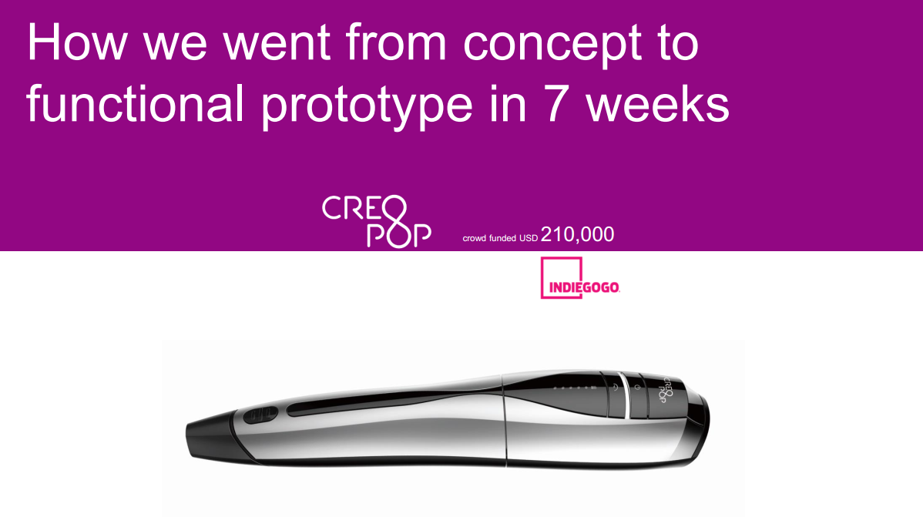
1. Introduction about building hardware products
Graph from Innozendesign

Slide 10
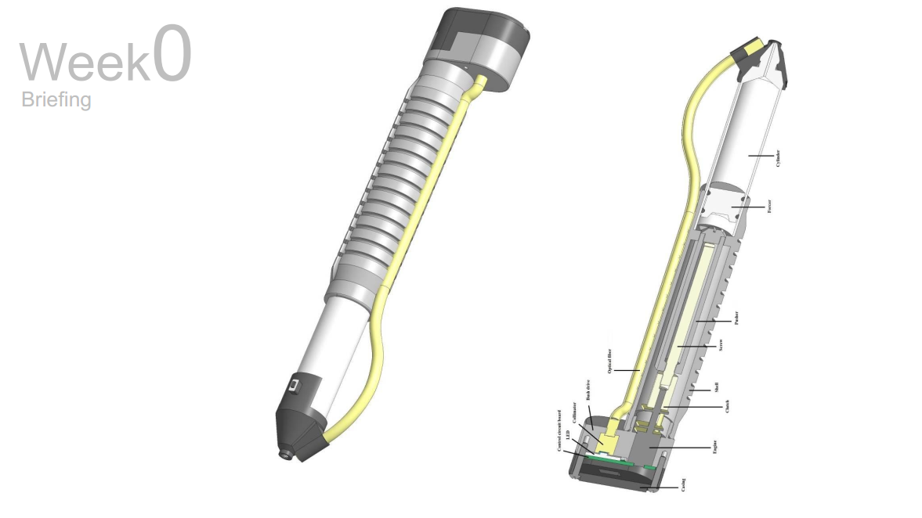
1. Introduction about building hardware products
Graph from Innozendesign

Slide 11
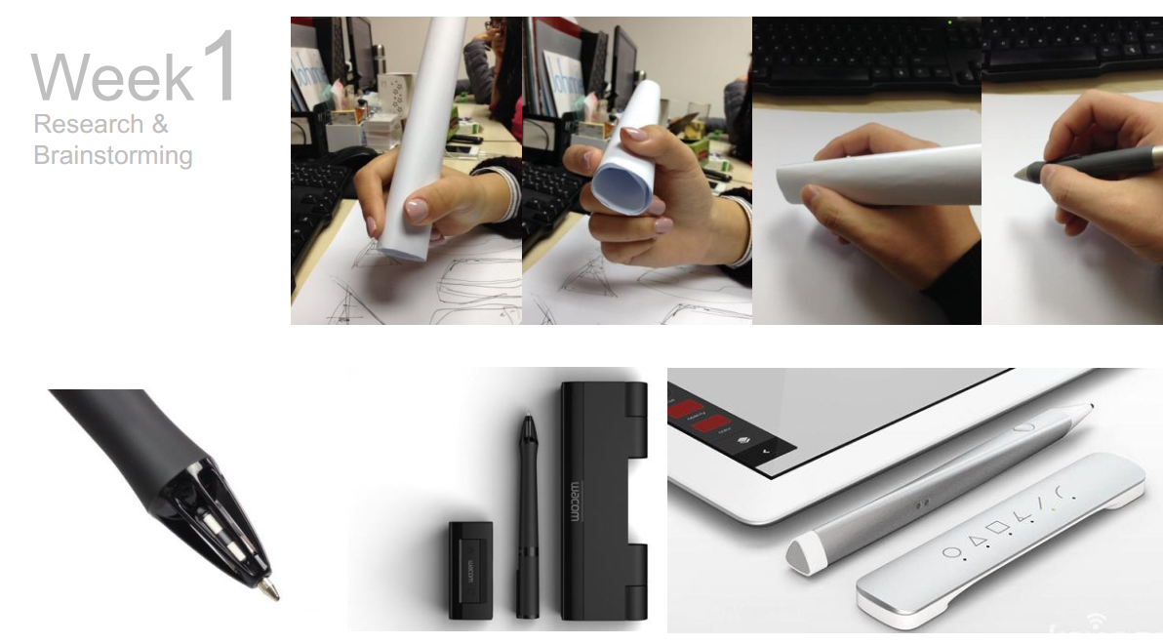
1. Introduction about building hardware products
Graph from Innozendesign

Slide 12
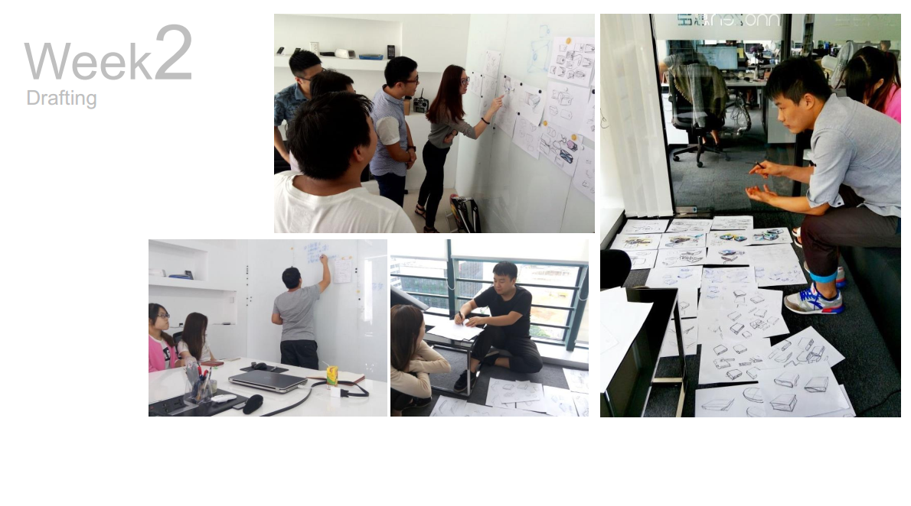
1. Introduction about building hardware products
Graph from Innozendesign

Slide 13
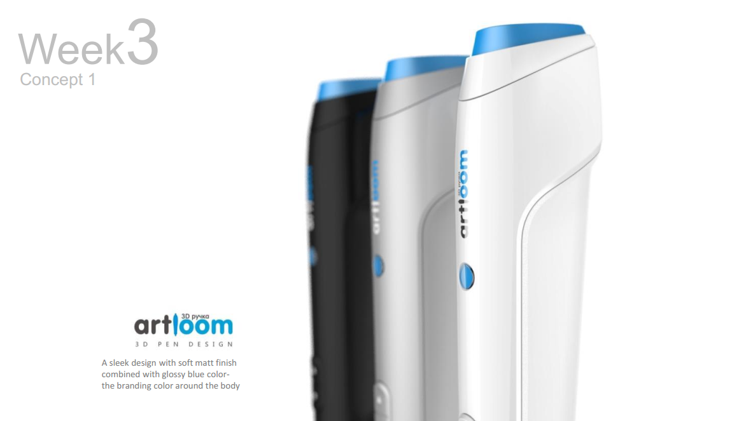
1. Introduction about building hardware products
Graph from Innozendesign

Slide 14
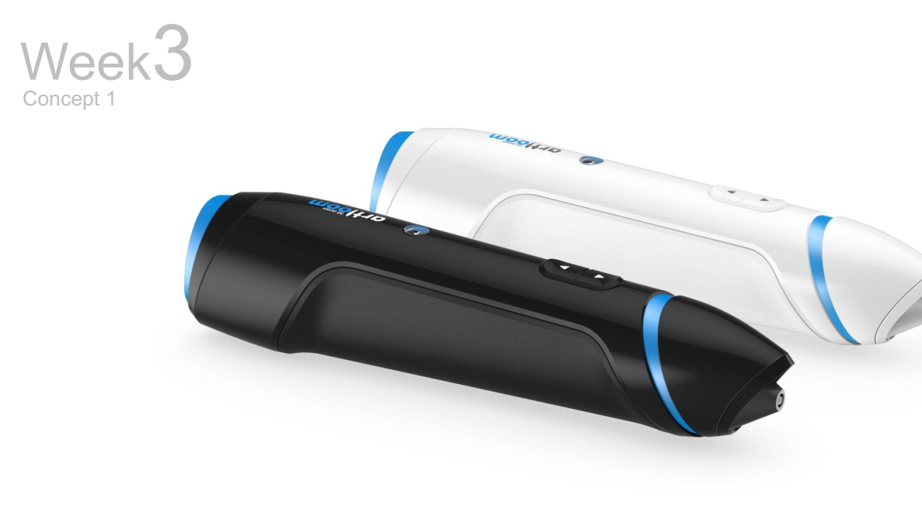
1. Introduction about building hardware products
Graph from Innozendesign

Slide 15
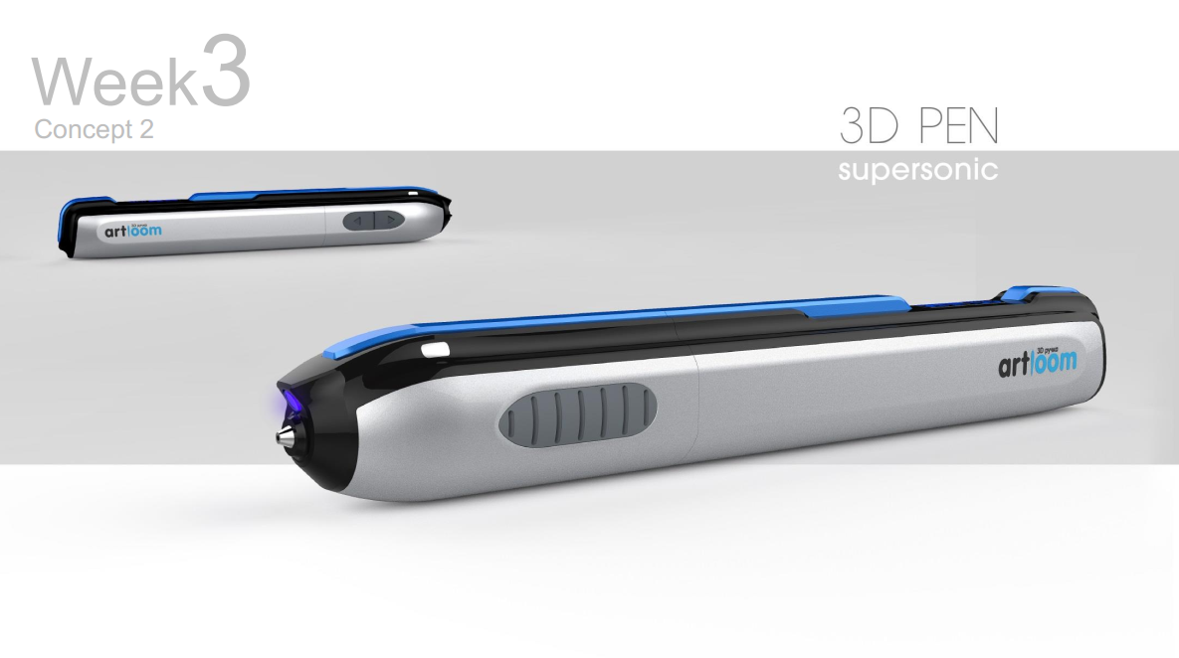
1. Introduction about building hardware products
Graph from Innozendesign

Slide 16
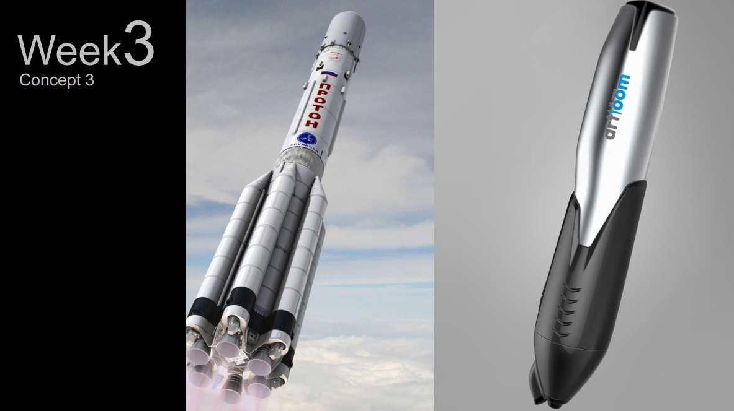
1. Introduction about building hardware products
Graph from Innozendesign

Slide 17
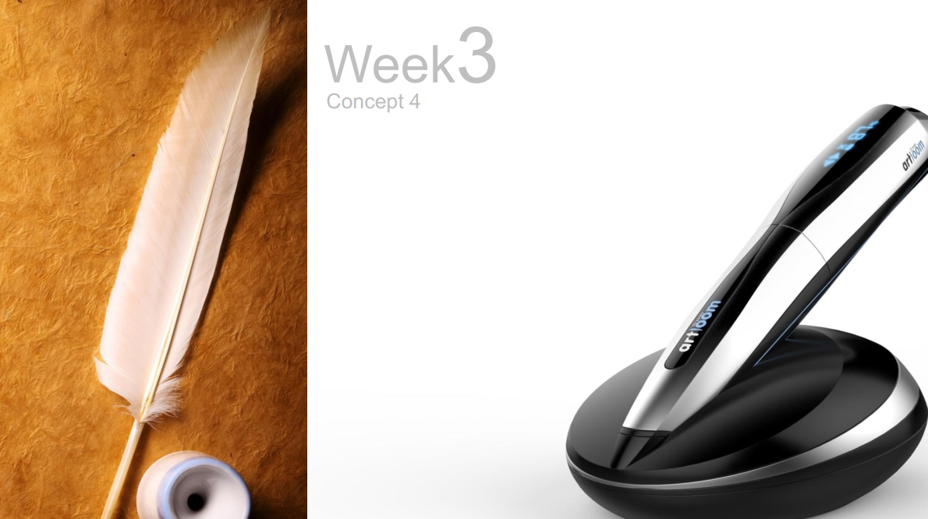
1. Introduction about building hardware products
Graph from Innozendesign

Slide 18
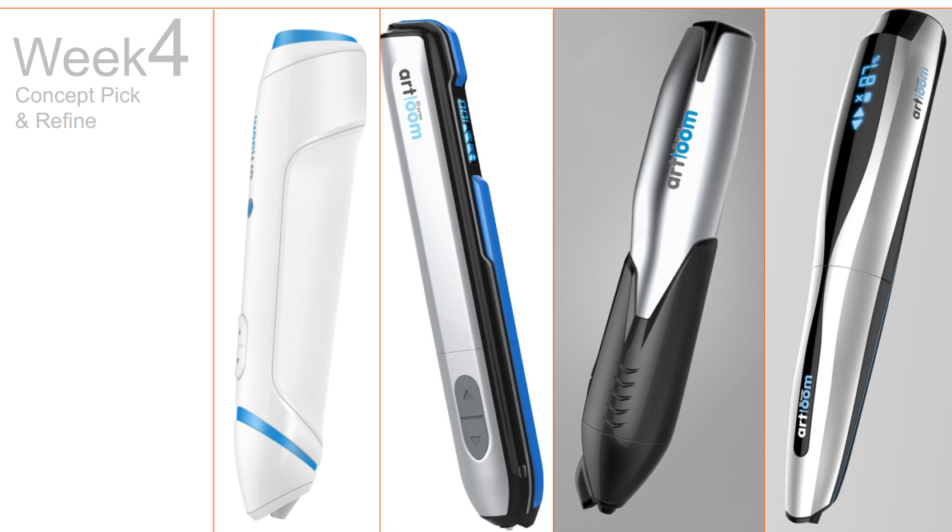
1. Introduction about building hardware products
Graph from Innozendesign

Slide 19
1. Introduction about building hardware products
PoC: Proof of Concept
EV: Engineering Verification
DV: Design Verification
PV: Product Verification
MP: Mass Production
Idea
Prototyping
Production

Slide 20
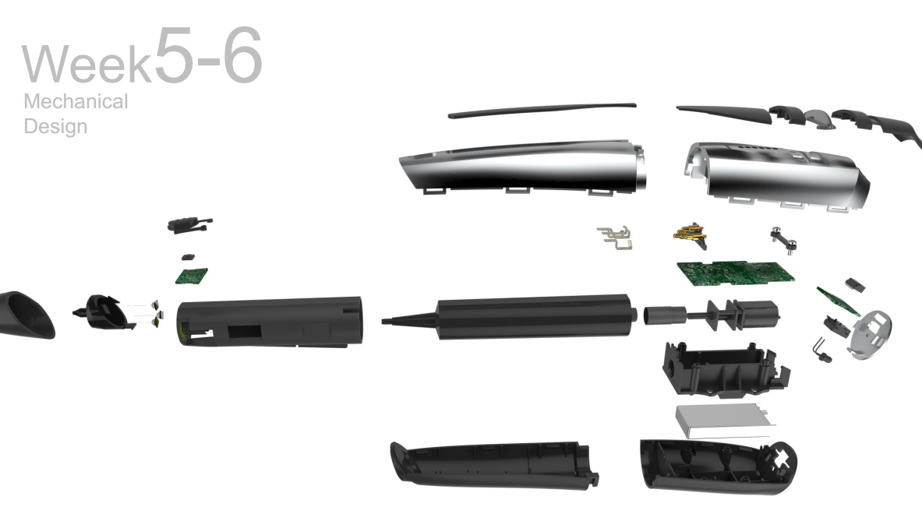
1. Introduction about building hardware products
Graph from Innozendesign

Slide 21
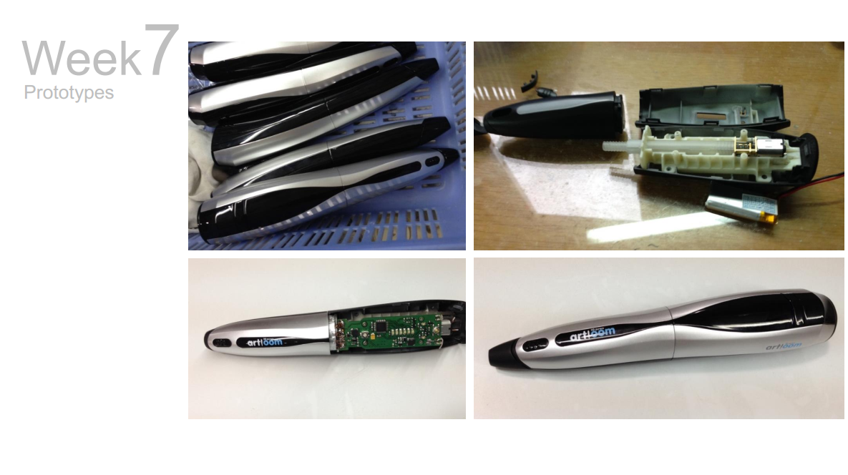
1. Introduction about building hardware products
Graph from Innozendesign

Slide 22
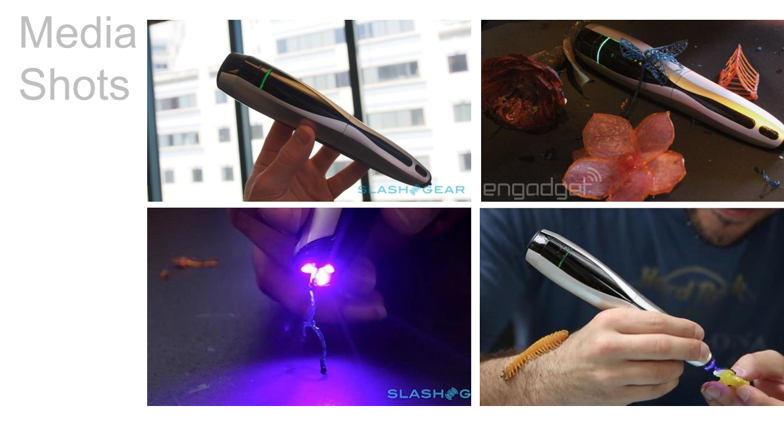
1. Introduction about building hardware products
Graph from Innozendesign

Slide 23
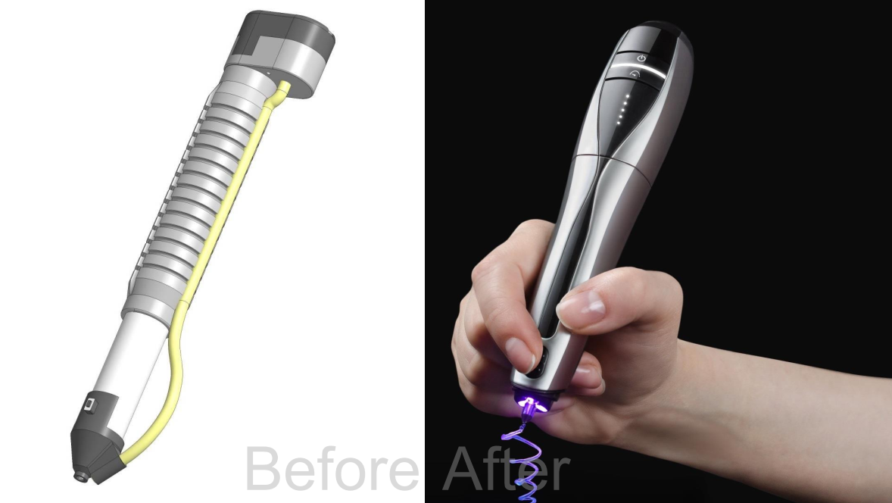
1. Introduction about building hardware products
Graph from Innozendesign

Slide 24
1. Introduction about building hardware products
PoC: Proof of Concept
EV: Engineering Verification
DV: Design Verification
PV: Product Verification
MP: Mass Production
Idea
Prototyping
Production

Slide 25
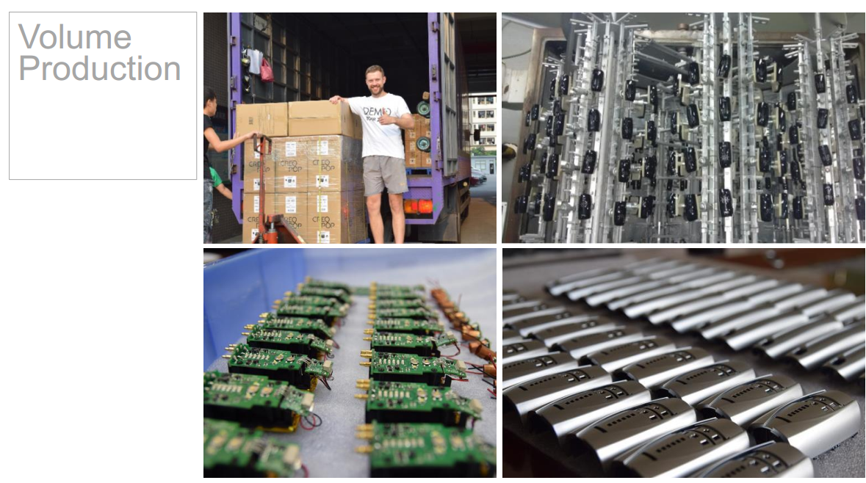
1. Introduction about building hardware products
Graph from Innozendesign

Slide 26
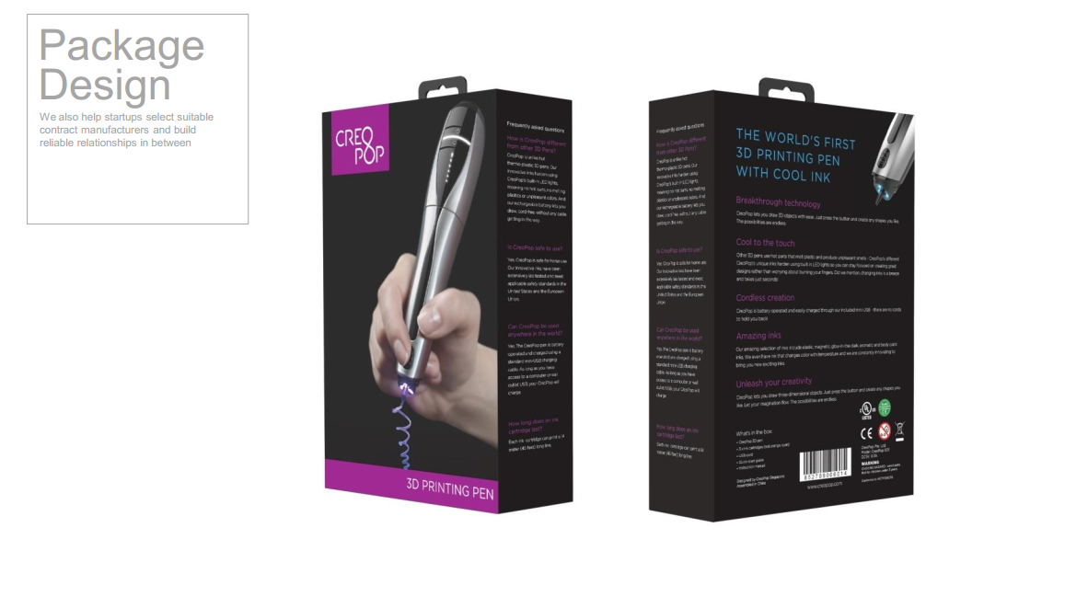
1. Introduction about building hardware products
Graph from Innozendesign

Slide 27
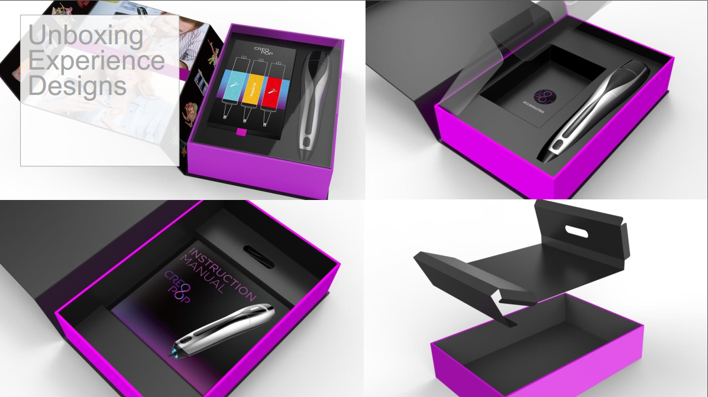
1. Introduction about building hardware products
Graph from Innozendesign

Slide 28
1. Introduction about building hardware products

Slide 29
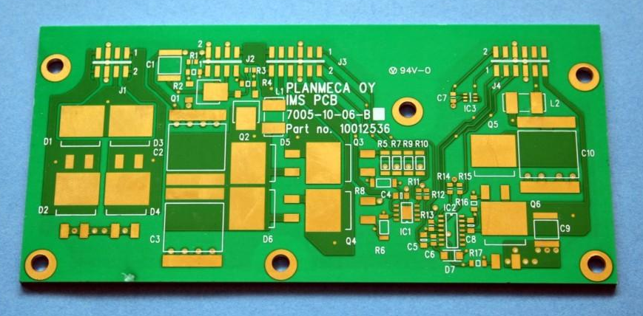
1. Introduction about building hardware products
PCB=Printed Circuit Board
Silkscreen
Solder mask
Outline
Pad
Through hole

Slide 30
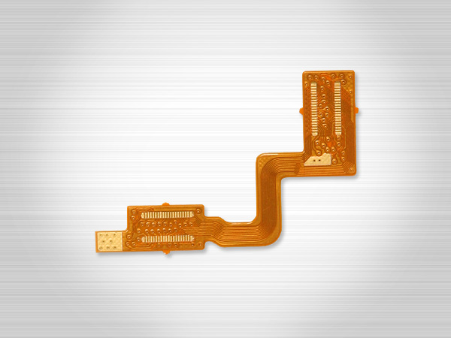
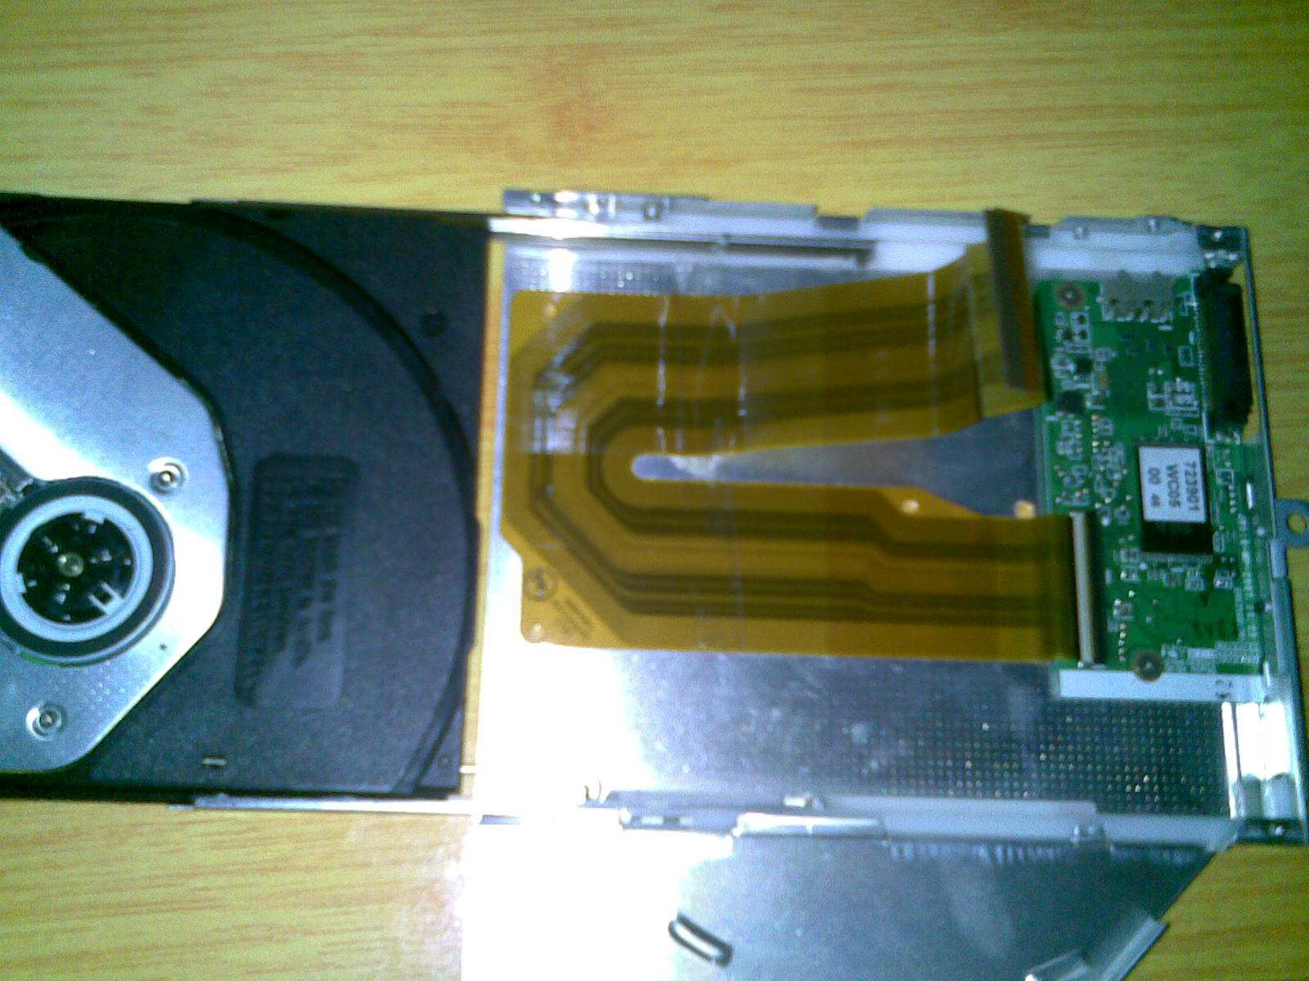
1. Introduction about building hardware products
FPC=Flexible Printed Circuit (Board)

Slide 31
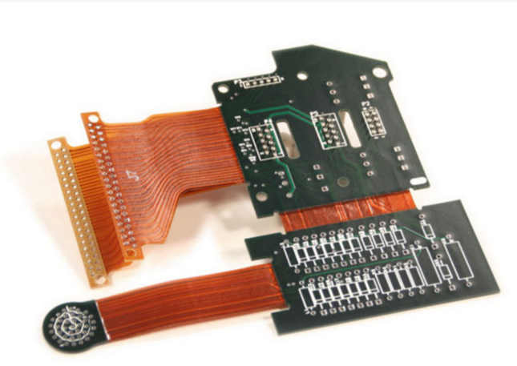
1. Introduction about building hardware products
Flex-rigid PCB

Slide 32
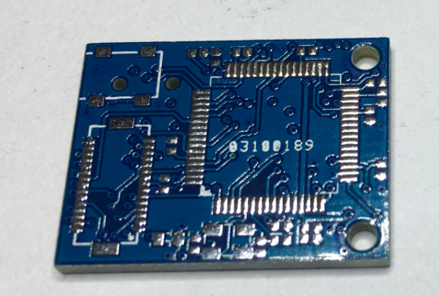
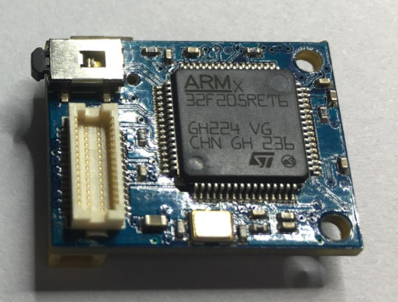
1. Introduction about building hardware products
SMT or PCBA
Surface Mount Technology / PCB Assembly

Slide 33
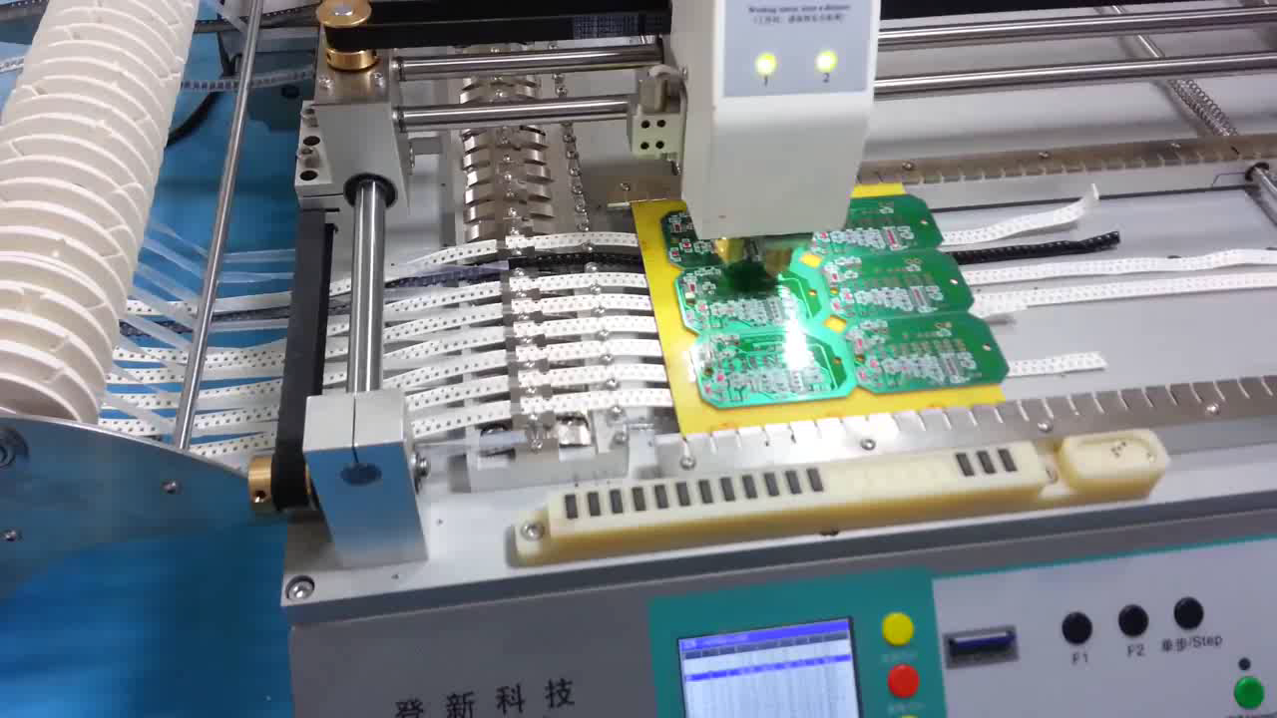
1. Introduction about building hardware products
How factories do that?
Small pick and place machine

Slide 34
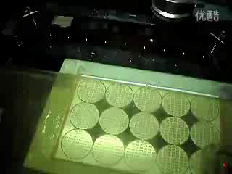
1. Introduction about building hardware products
How factories do that?
High speed SMT machine

Slide 35
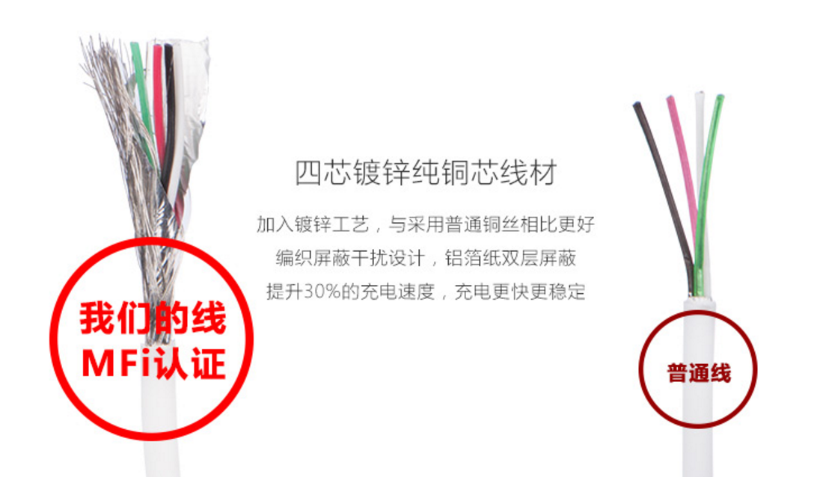
1. Introduction about building hardware products
Cables & connectors
Shielding:
Aluminum foil + braid
Skin:
TPE

Slide 36
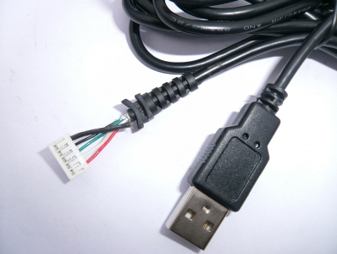
1. Introduction about building hardware products
Cables & connectors
Reliability:
SR (Strain Relief)
Logo:
Yes, on the USB port

Slide 37
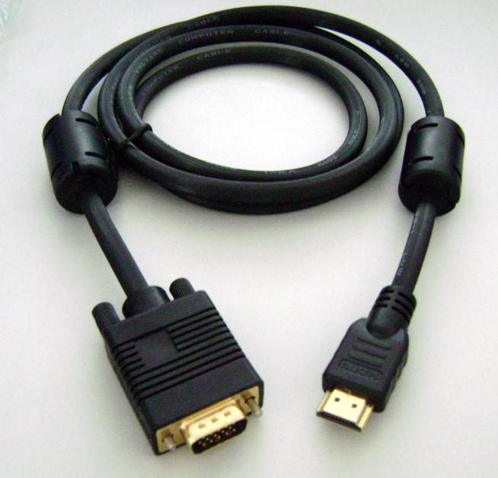
1. Introduction about building hardware products
Cables & connectors
Noise control:
Add magnetic bead if longer than 1 m

Slide 38
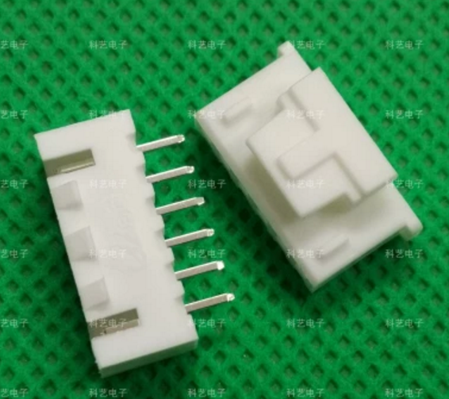
1. Introduction about building hardware products
Cables & connectors
Choose connectors with lock if needed

Slide 39
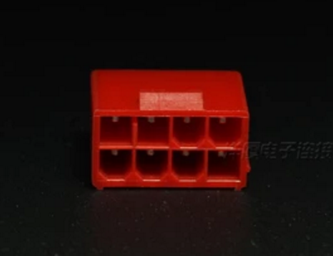
1. Introduction about building hardware products
Cables & connectors
Make fool-proof design

Slide 40
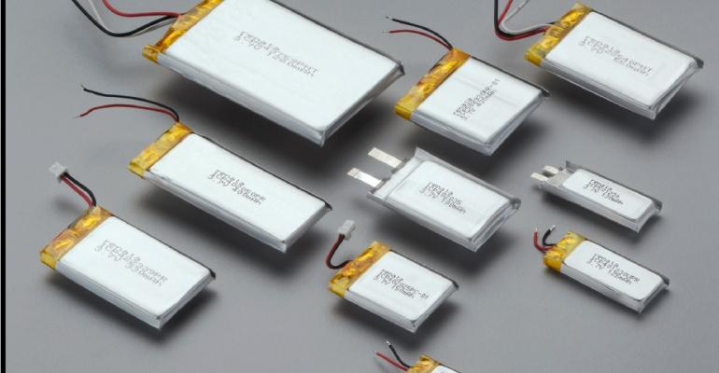
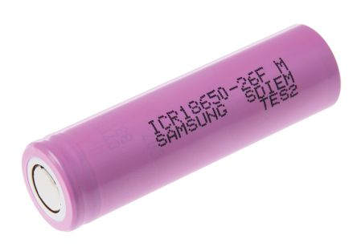
1. Introduction about building hardware products
Battery type
Lithium polymer batteries (soft packet)
Lithium ion batteries with cylindrical metal case

Slide 41
1. Introduction about building hardware products
Battery type
Lithium polymer batteries (soft packet)
+ Safe, lightweight, customizable dimension
- Needs expansion space and case protection

Slide 42
1. Introduction about building hardware products
Battery type
Lithium ion batteries with cylindrical metal case
+ Very mature in industry, relatively lower cost
- Heavy, only certain sizes available

Slide 43
1. Introduction about building hardware products
Certifications
U.S. | FCC
Europe | CE
Canada | IC
China | CCC/SRRC
Bluetooth | BQB
Chemical | RoHS, REACH

Slide 44
1. Introduction about building hardware products
Injection molding
Making plastics in a very efficient and cheap way!

Slide 45
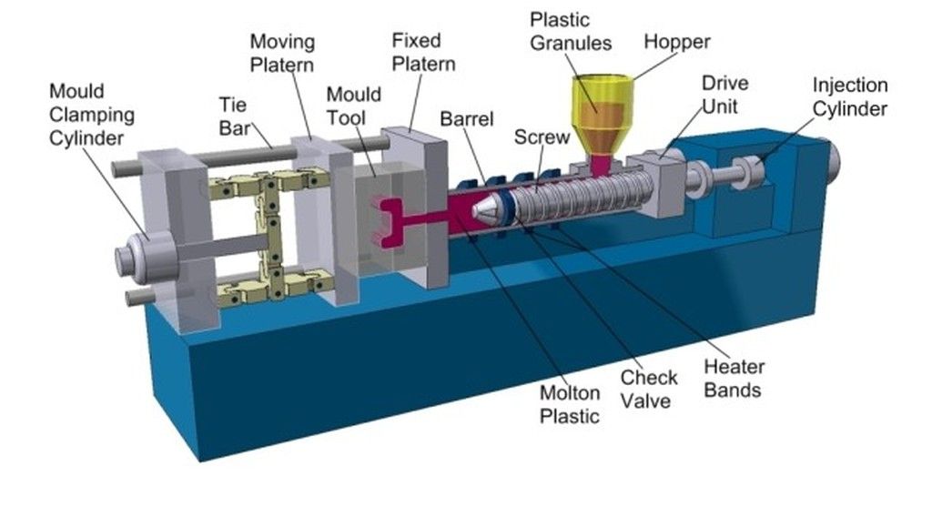
1. Introduction about building hardware products
Injection molding

Slide 46
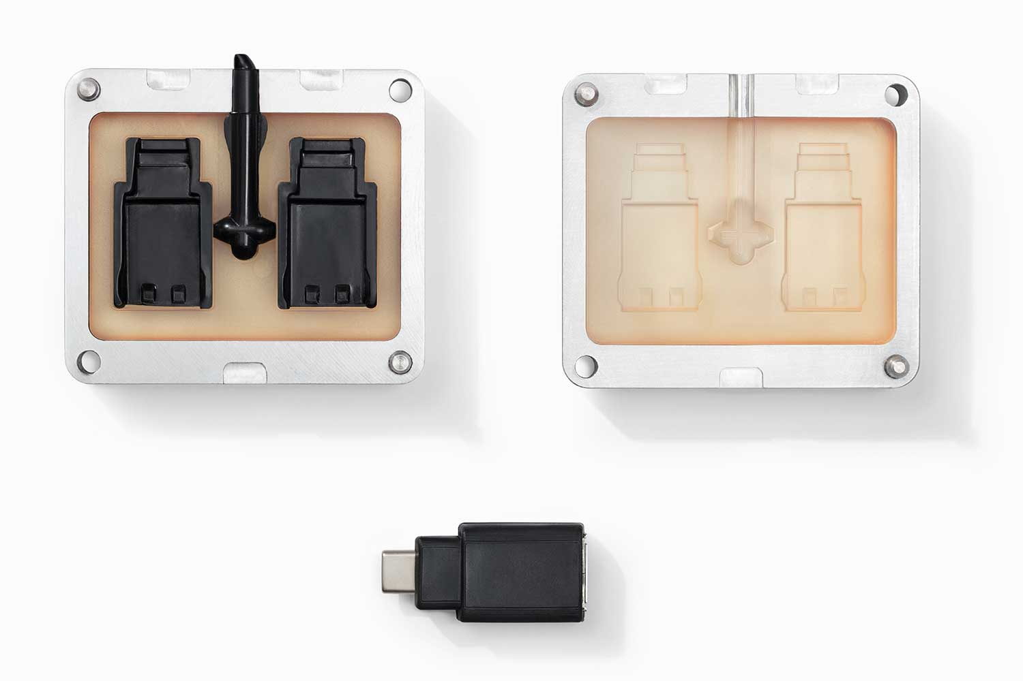
1. Introduction about building hardware products
Injection molding
Step 0: build metal tooling

Slide 47
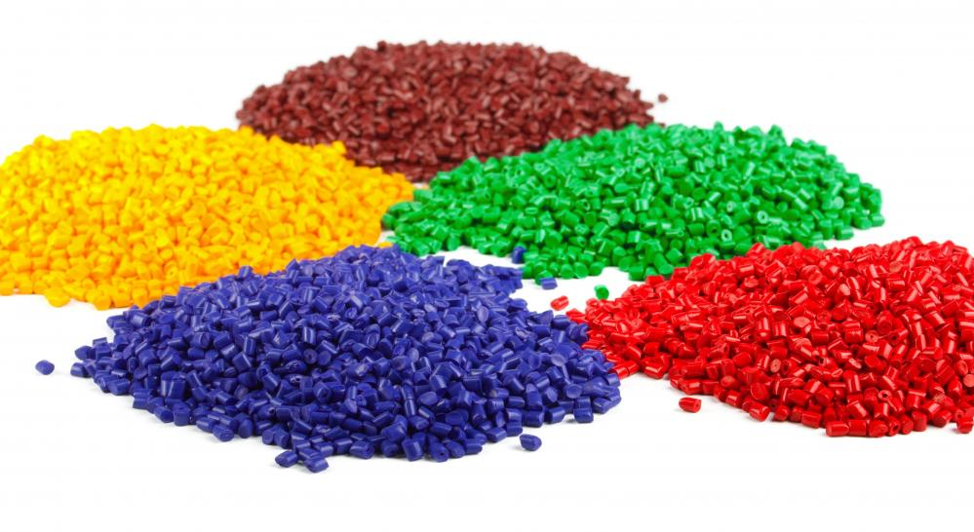
1. Introduction about building hardware products
Injection molding
Step 1: melt raw material

Slide 48
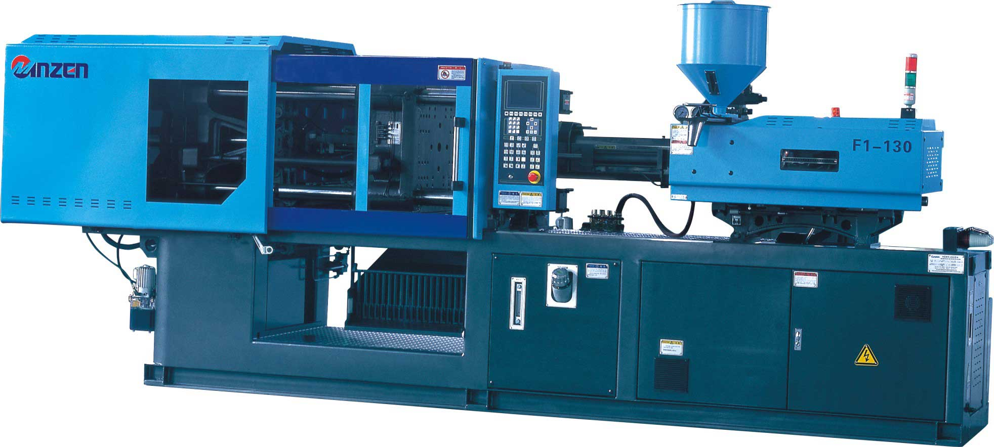
1. Introduction about building hardware products
Injection molding
Step 2: inject into chamber

Slide 49
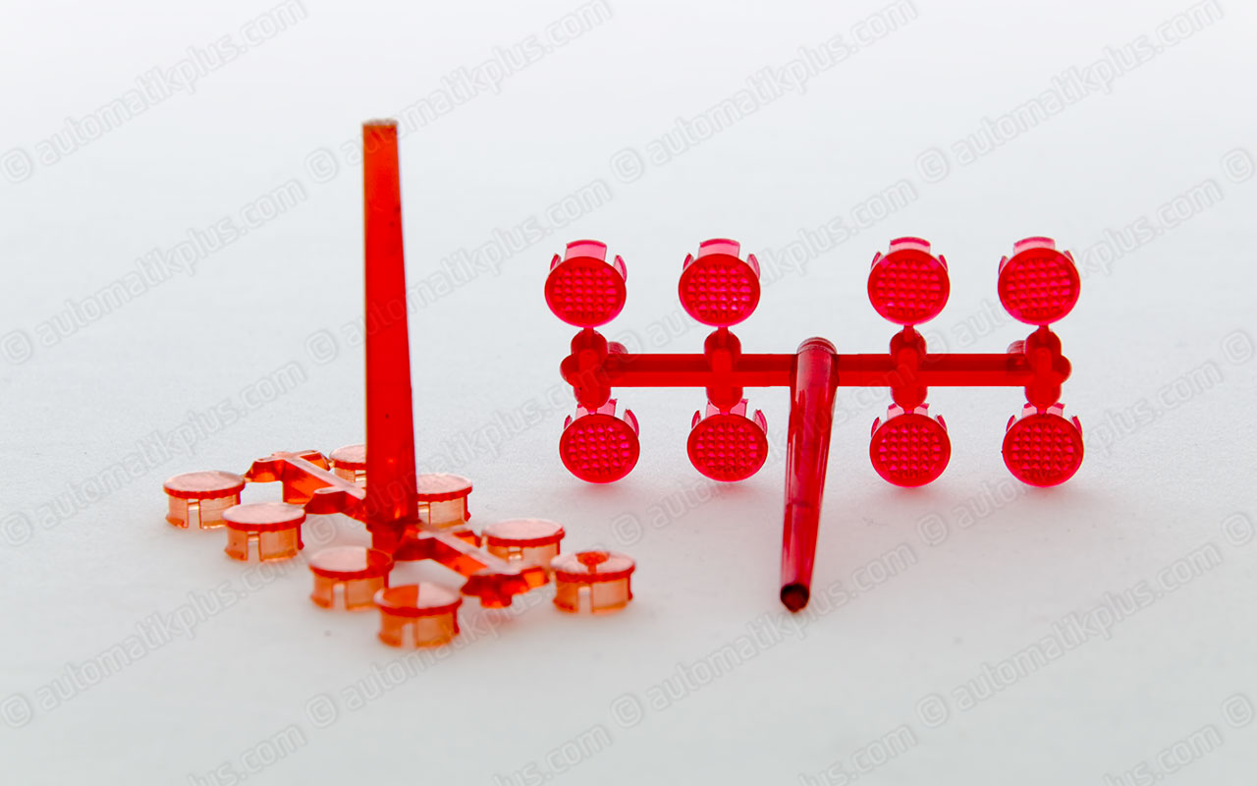
1. Introduction about building hardware products
Injection molding
Step 3: Cooldown and detach tooling

Slide 50
1. Introduction about building hardware products
Product Development Plan
Stage | PoC | EV | DV | PV | MP
# of units | 1 | 5~10 | 10~50 | 50~200 | >1,000
EE | Breadboard | Big PCB Module | PCB scale down Switch out modules | PCB lock BOM lock | QC
ME | Tape & glue Foam board Card board | 3D print CNC | Tooling sample | Tooling verify | QC
Testing | Function test Physical size | Basic EE/ME test | RF & safety test Reliability test | Certification Complete reliability test
PoC: Proof of Concept EV: Engineering Verification
DV: Design Verification PV: Product Verification
MP: Mass Production

Slide 51
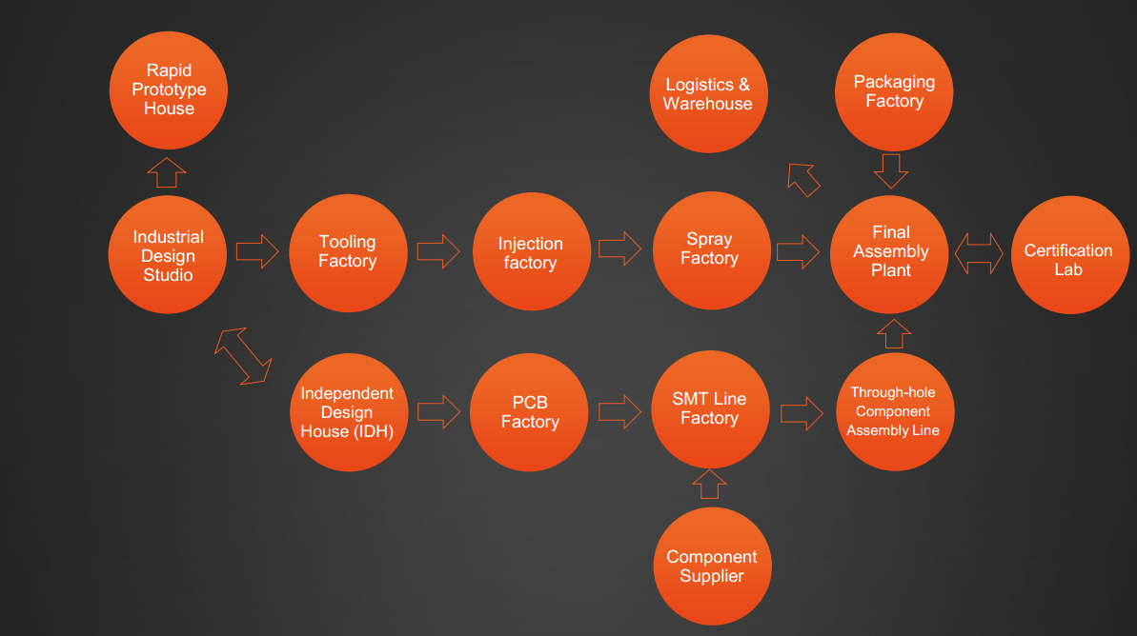
2. Shenzhen’s advantages in hardware
Graph from Innozendesign

Slide 52
2. Shenzhen’s advantages in hardware
What kind of services would be needed to build a hardware startup?
Industrial design companies
Hardware electronics market
Electronics and mechanical factories
Assembly and packaging
Inspection and certifications
Shipping
ALL local in Shenzhen!

Slide 53
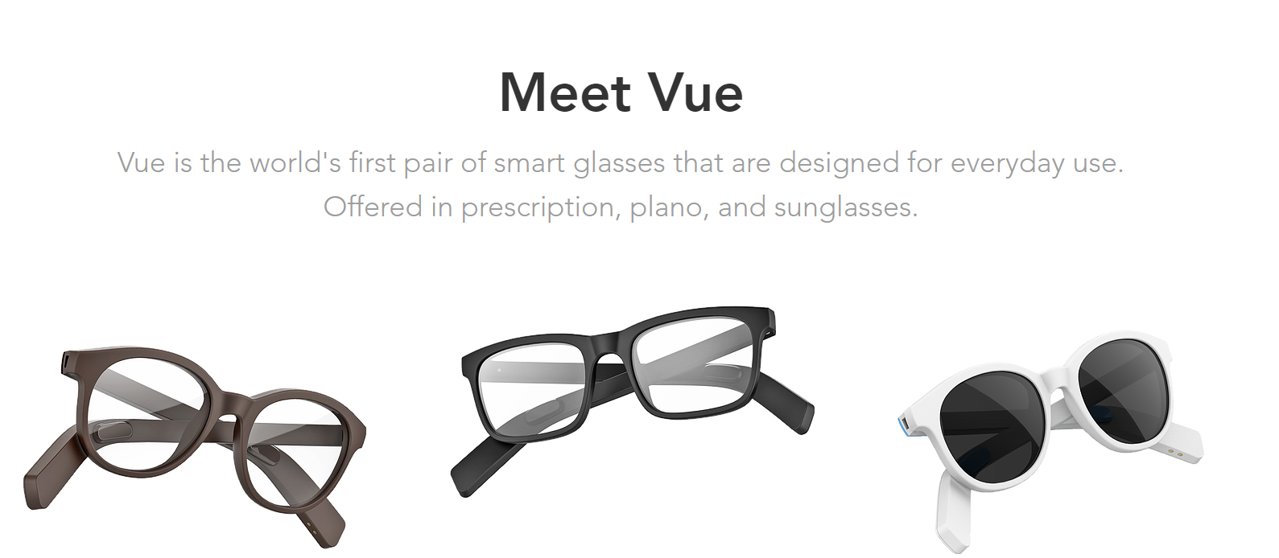
3. Hardware startups in Shenzhen
Vue
$2,215,583 USD on Kickstarter
Resources from Vue

Slide 54
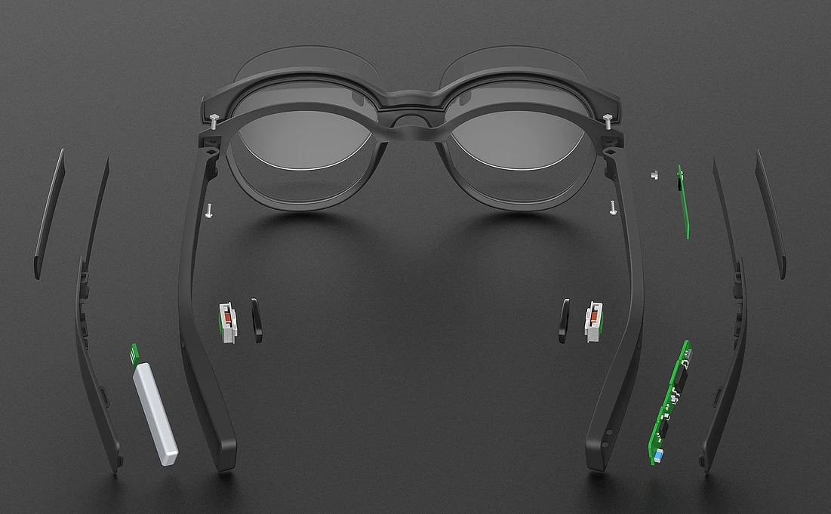
3. Hardware startups in Shenzhen
Vue
Resources from Vue

Slide 55


3. Hardware startups in Shenzhen
Vue
Resources from Vue

Slide 56



3. Hardware startups in Shenzhen
Vue
Jason Gui, Co-founder of Vue
Tiantian Zhang, Co-founder of Vue
Forbes 30 under 30
Resources from Vue

Slide 57

3. Hardware startups in Shenzhen
Lief
Resources from Lief

Slide 58
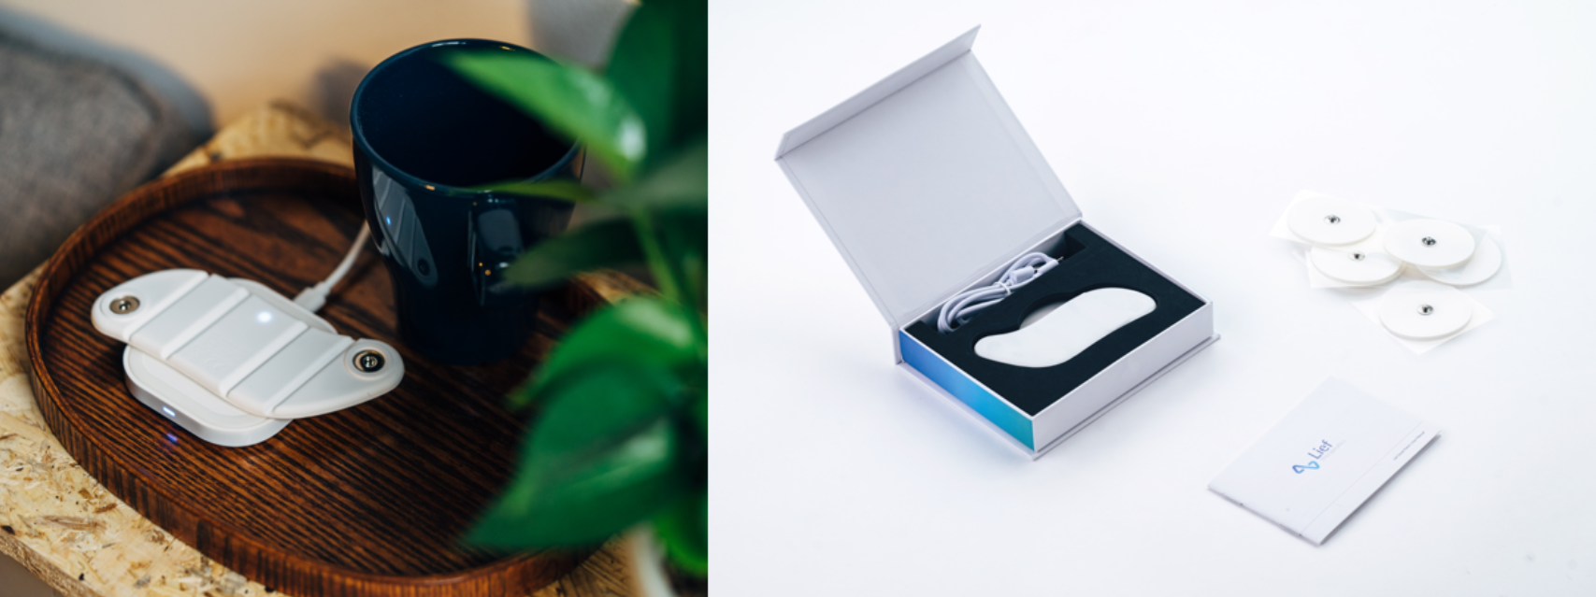
3. Hardware startups in Shenzhen
Lief
Resources from Lief

Slide 59
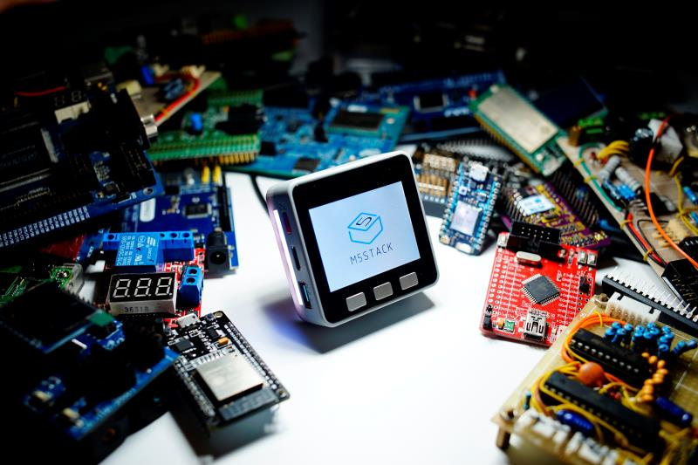
3. Hardware startups in Shenzhen
M5 Stack
Resources from M5 Stack

Slide 60
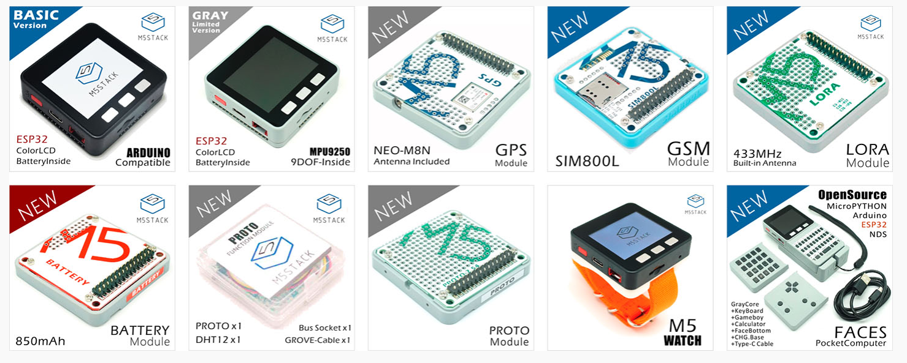
3. Hardware startups in Shenzhen
M5 Stack
Resources from M5 Stack

Slide 61
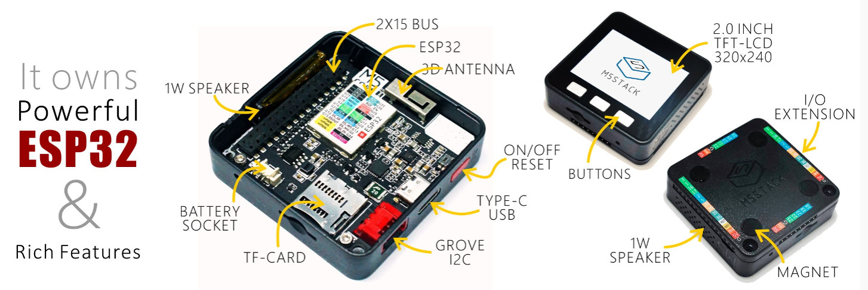
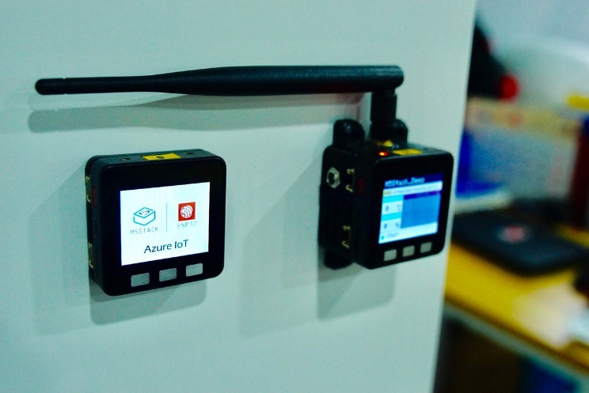
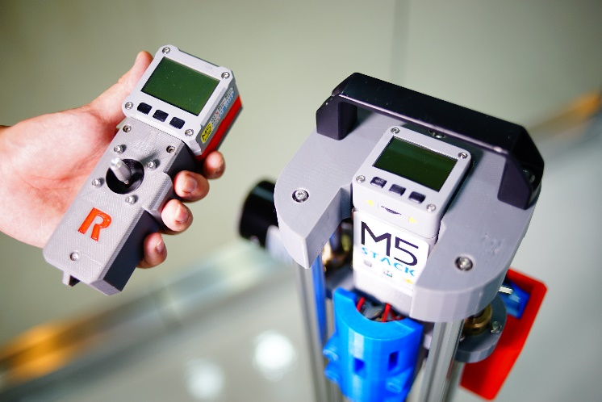
3. Hardware startups in Shenzhen
M5 Stack
Resources from M5 Stack

Slide 62
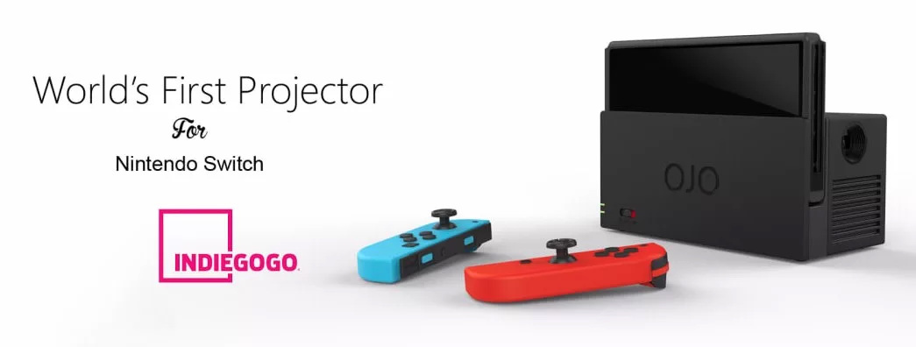
3. Hardware startups in Shenzhen
YesOJO
Resources from YesOJO

Slide 63
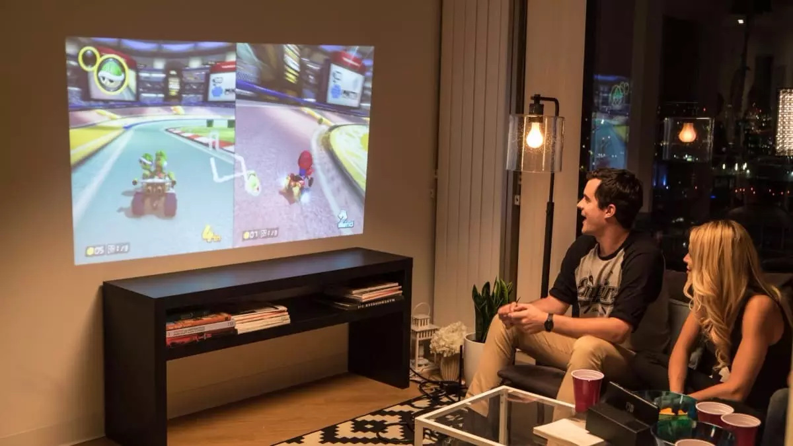
3. Hardware startups in Shenzhen
YesOJO
Resources from YesOJO

Slide 64
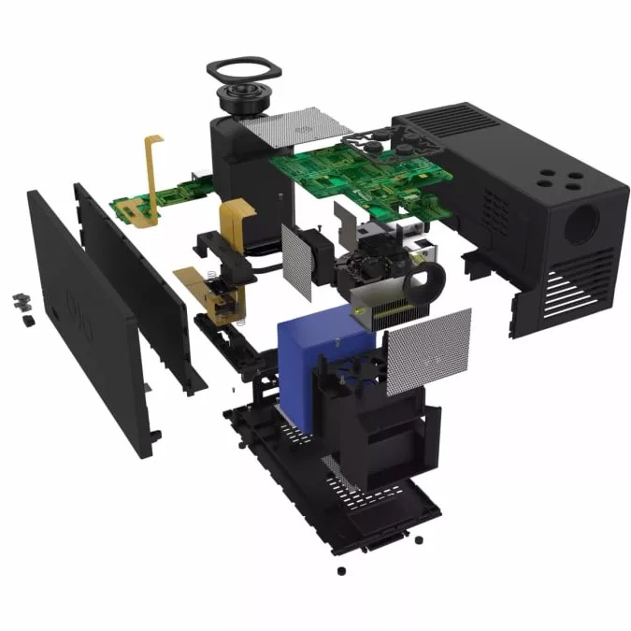
3. Hardware startups in Shenzhen
YesOJO
Resources from YesOJO

Slide 65
3. Hardware startups in Shenzhen
YesOJO
Mar 2017 Nintendo Switch released
Apr 2017 Idea born for Switch projector
Jul 2017 Team setup
Aug 2017 First prototype
Oct 2017 Indiegogo crowdfunding started
Dec 2017 Funding successful
Jan 2018 First batch shipped
Resources from YesOJO

Slide 66
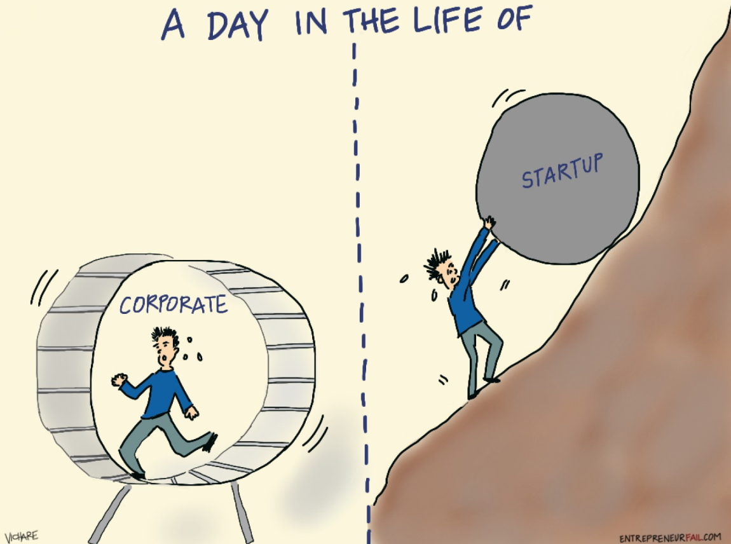
4. Experiences in startup companies

Slide 67


4. Experiences in startup companies
Comparison in | Big Corporates | Startups
Working style | Clear target Clear instructions Clear timeline Clear result | Clear target Partial instructions Uncontrolled timeline Unknown result

Slide 68


4. Experiences in startup companies
Comparison in | Big Corporates | Startups
Skill set required | Specialized skill point Deep research | Full stack General level

Slide 69


4. Experiences in startup companies
Comparison in | Big Corporates | Startups
Pressure | Medium, manageable | High, most of the time

Slide 70


4. Experiences in startup companies
Comparison in | Big Corporates | Startups
Reward | Medium to high Predictable | None to extremely high Not predictable

Slide 71


4. Experiences in startup companies
Comparison in | Big Corporates | Startups
Risk | Low | High, or extremely high

Slide 72
4. Experiences in startup companies
Comparison in | Big Corporates | Startups
Working style | Clear target Clear instructions Clear timeline Clear result | Clear target Partial instructions Uncontrolled timeline Unknown result
Skill set required | Specialized skill point Deep research | Full stack General level
Pressure | Medium, manageable | High, most of the time
Reward | Medium to high Predictable | None to extremely high Not predictable
Risk | Low | High, or extremely high

Slide 73
Q&A

Slide 74
Thank you

